Slide 1
CS 4530
Software Engineering
Lecture 3 - Design Patterns
Jonathan Bell, John Boyland, Mitch Wand
Khoury College of Computer Sciences

Slide 2

Zoom Mechanics
Recording: This meeting is being recorded
If you feel comfortable having your camera on, please do so! If not: a photo?
I can see the zoom chat while lecturing, slack while you’re in breakout rooms
If you have a question or comment, please either:
“Raise hand” - I will call on you
Write “Q: <my question>” in chat - I will answer your question, and might mention your name and ask you a follow-up to make sure your question is addressed
Write “SQ: <my question>” in chat - I will answer your question, and not mention your name or expect you to respond verbally

Slide 3
Today’s Agenda
Administrative:
HW1 Discussion, due next Friday
Design patterns discussion
Activity: observer pattern

Slide 4
Reflection: What's a software design problem you've solved from an idea you learned from someone else?
Discuss in small groups for 15 minutes, then at least 3-5 people will share their experiences with the whole class

Slide 5
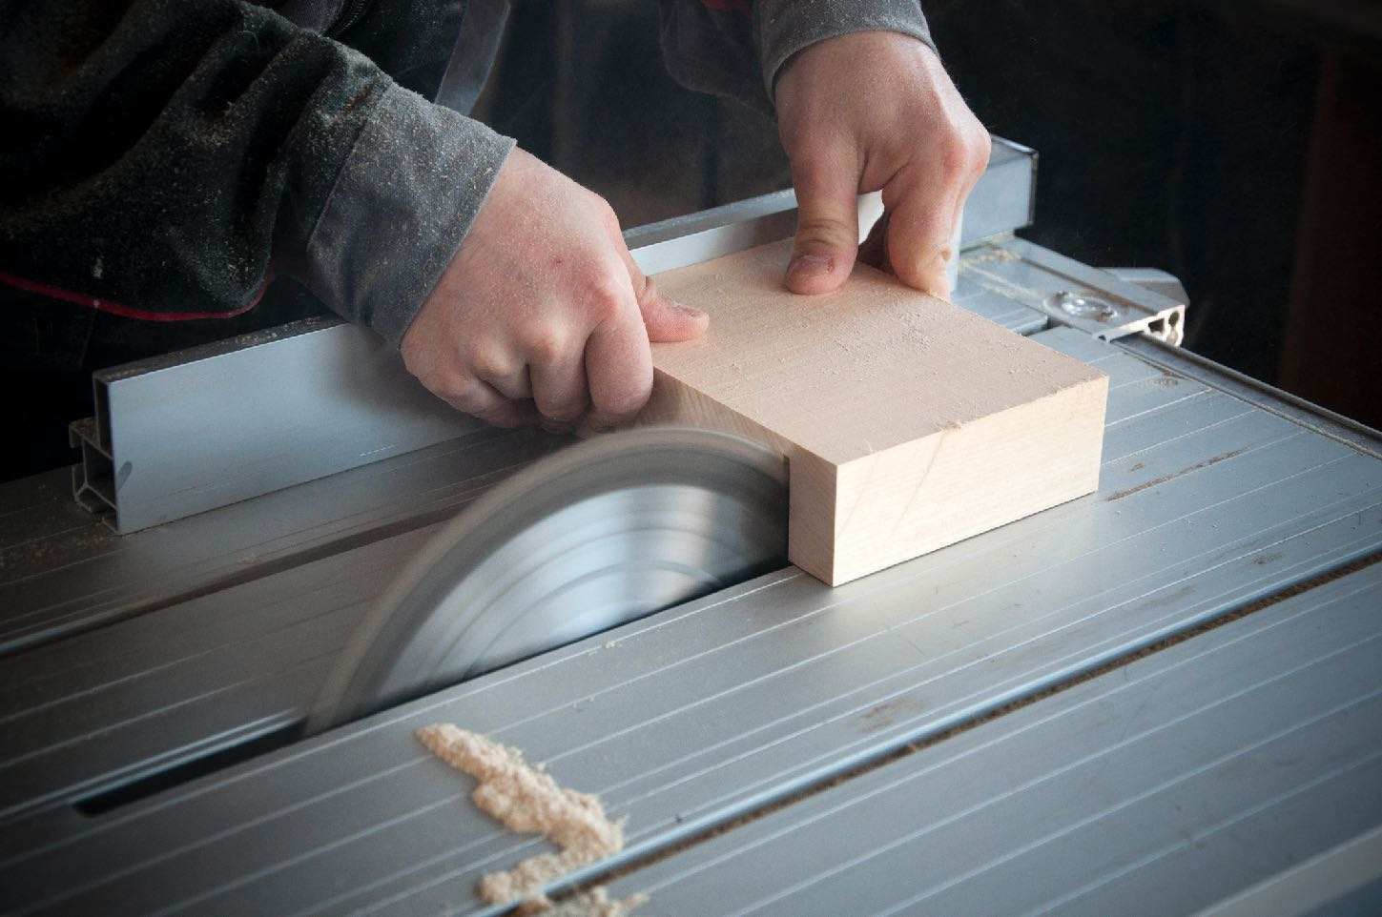
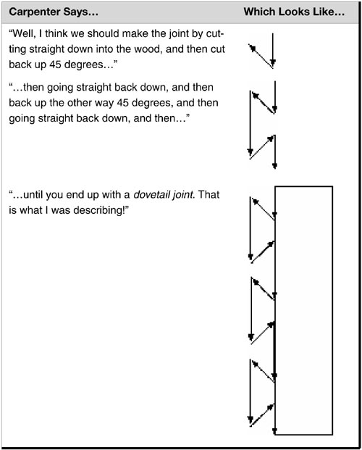
Review: Design Patterns
A design conversation
Q: How should we build a stack of drawers?
A: Well, I think we should make the joint by cutting straight down into the wood, and then cut back up 45 degrees, and then going straight back down, and then back up the other way 45 degrees, and then going straight back down, and then…
“Design Patterns Explained”, Shalloway and Trott, Addison-Wesley, 2005

Slide 6

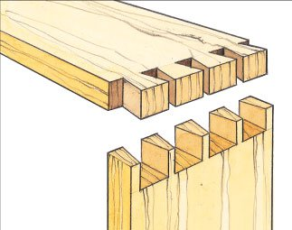
Review: Design Patterns
Asking the wrong questions
Carpenter: Should we use a dovetail or miter joint?
Other carpenter: Use a miter, it’s: lighter and inconspicuous. A dovetail is a more complex, expensive joint that will be impervious to temperature and humidity, and it will look better. But, nobody will see the joint in the drawer, and it won’t be in a situation with changing heat and humidity.
Dovetail Joint
“Design Patterns Explained”, Shalloway and Trott, Addison-Wesley, 2005
Miter Joint
Notes:
Carpenter: Should we make a joint that is more expensive, but more visually appealing and durable, or a quick and dirty one that will last at least until we get paid?

Slide 7
More of Christopher Alexander’s Patterns
No. 82: Office Connections
“If two parts of an office are too far apart, people will not move between them as often as they need to, and if they are more than one floor apart, there will be almost no communication between the two”
“A Pattern Language: Towns, Buildings, Construction,” C Alexander et al. pg 408-409

Slide 8

Why Design Patterns?
The OG meme (1975)
Notes:
While the gang of four took design patterns to be a framework for teaching
“But of course ,in order to create order, not chaos, people must have some shared principles”

Slide 9
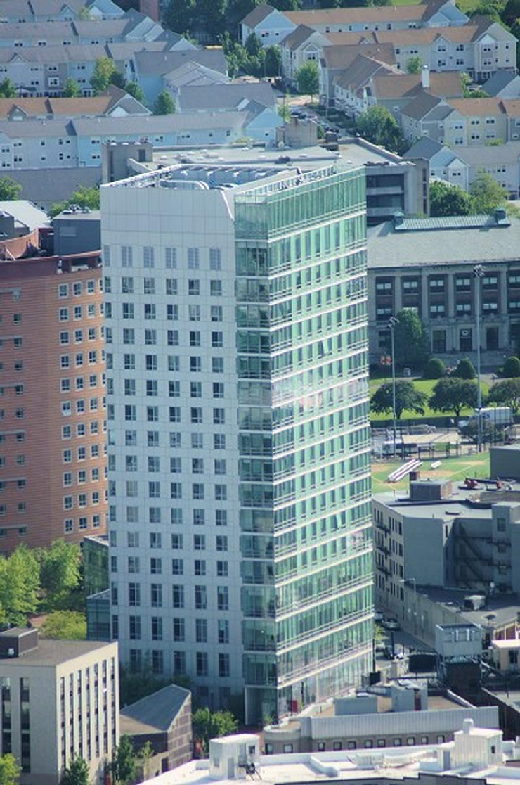
More of Christopher Alexander’s Patterns
Domain-Specific Patterns
9. Living Learning Circle:
Students who want to live closely related to the university want their housing integrated with the university; yet most on-campus housing provided today is zoned off from academic departments. Therefore: Provide housing for 25 per cent of the student population within the 3000 for inner university diameter. Do not zone this housing off from academic departments…”
“The Oregon Experiment,” C Alexander et al. pg 114

Slide 10
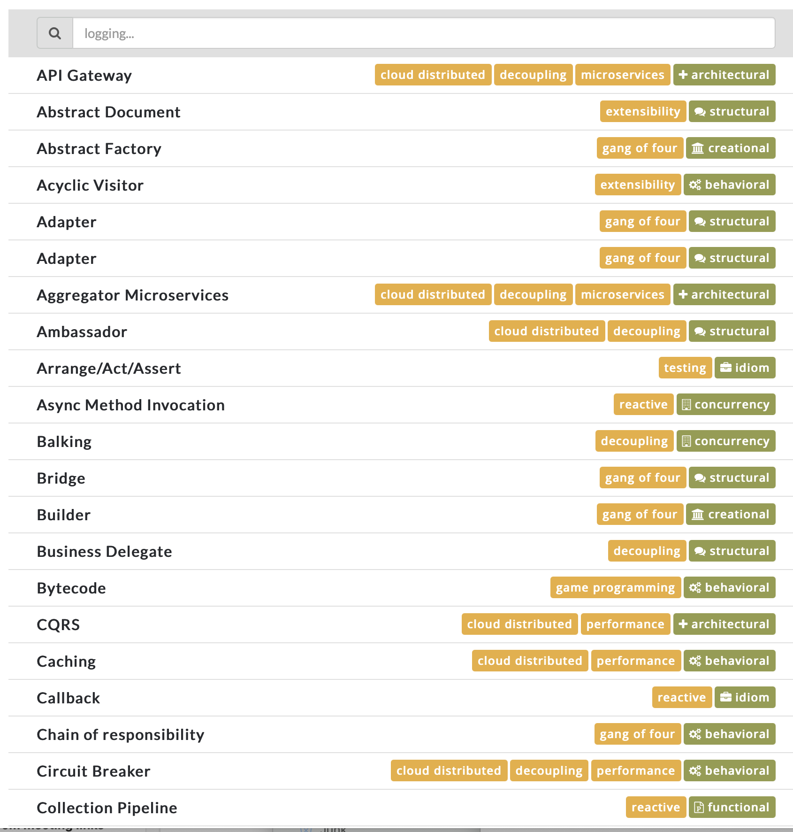
More (Software) Design Patterns
Just like Alexander expected more patterns to be “discovered” in architecture, same happens in code…
https://java-design-patterns.com/patterns/ : 109+ patterns
Patterns might be local to:
A language
A framework
A project
Notes:
“Every particular community will always need to do the same to supplement the general patterns from A Pattern Language”

Slide 11

Design Patterns
Discusison: Is it about vocabulary, or is it about training?
“None of the design patterns in this book describes new or unproven designs. We have included only designs that have been applied more than once in different systems. Most of these designs have never been documented before. They are either part of the folklore of the object-oriented community or are elements of some successful object-oriented systems—neither of which is easy for novice designers to learn from.”

Slide 12
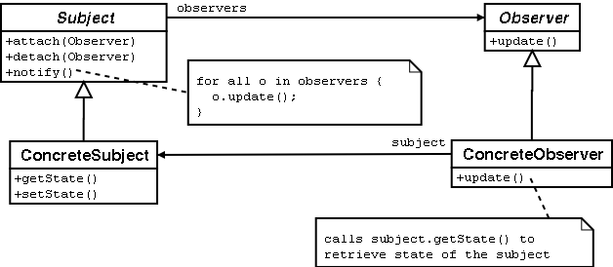
Review: Observer Pattern
Aka Publish/Subscribe
The object being observed (the "subject") keeps a list of the people who need to be notified when something changes.
When a new object wants to be notified when the subject changes, it registers with ("subscribes to") with the subject
Observer
defines an interface for objects that should be notified of changes
ConcreteObserver
maintains reference to an object
stores state that should stay consistent with subject’s
implements the Observer interface to keep state consistent with the subject’s
Subject
provides an interface for attaching/detaching observers
ConcreteSubject
stores state of interest to observers
sends a notification to its observers when state changes

Slide 13
Review: Observer Pattern
class Clock implements IPublishingClock {
// clock functionality
private clockTime = 0
public tick () {this.clockTime++; this.publishTickEvent()}
public reset() {this.clockTime=0; this.publishResetEvent()}
private observers : ClockObserver[]
// register responds with the current time, so the observer
// will be initialized
public subscribe(obs:ClockObserver): void {
this.observers.push(obs);
obs.onTick(this.clockTime)
}
private publishTickEvent() {
this.observers.forEach(obs => {obs.onTick(this.clockTime)})
}
private publishResetEvent() {
this.observers.forEach(obs => {obs.onReset()})
}
}
export interface IPublishingClock { // reset the tick counter
reset(): void
// increment the tick counter
tick(): void
// subscribe a new observer
subscribe(obs:ClockObserver) : void
}
export interface ClockObserver { // action to take when clock ticks
onTick(time:number):void
// action to take when the clock resets
onReset():void
}
Notes:
The protocol is:
When the clock ticks, it sends an onTick message with the current time to each subscriber (observer)
When the clock resets, it sends an onReset message to each subscriber.
When a new subscriber registers, the clock responds by sending it an onTick message

Slide 14

Programming Activity
Weather Station
We have prepared some code for a weather station, with a class WeatherData that stores the current temperature, pressure and humidity, and several display classes that format the data, e.g.:
export default class StatisticsDisplay {
private _maxTemp = 0;
private _minTemp = 0;
private _tempSum = 0;
private _numReadings = 0;
displayStatistics(currentData: WeatherData): void {
this._tempSum += currentData.temperature;
this._numReadings += 1;
if (this._maxTemp < currentData.temperature) {
this._maxTemp = currentData.temperature;
}
if (this._minTemp > currentData.temperature) {
this._minTemp = currentData.temperature;
}
// eslint-disable-next-line
console.log('Avg/max/min temperature = %f/%i/%i', this._tempSum / this._numReadings, this._maxTemp, this._minTemp);
}
}
Sample output from running all of the displays: Avg/max/min temperature = 80/80/0
Forecast: Improving weather on the way!
Current conditions: 80F degrees and 65% humidity
Heat Index: 82.95535063710001

Slide 15
Programming Activity
CRC card for the current class:
Class: WeatherData
State: current temperature, humidity, pressure
Responsibilities: Keep track of current weather Push changes to displays | Collaborators: StatisticsDisplay ForecastDisplay CurrentConditionsDisplay HeatIndexDisplay
Observer Pattern
File: WeatherData.ts
public setMeasurements(temperature: number, humidity: number, pressure: number): void {
this._temperature = temperature;
this._humidity = humidity;
this._pressure = pressure;
this.measurementsChanged();
}
private measurementsChanged() {
this._statisticsDisplay.displayStatistics(this);
this._forecastDisplay.displayForecast(this);
CurrentConditionsDisplay.displayCurrentConditions(this);
HeatIndexDisplay.displayHeatIndex(this);
}
Your task: rewrite these classes to follow the observer pattern
CRC card after your changes:
Class: WeatherData
State: current temperature, humidity, pressure
Responsibilities: Keep track of current weather Push changes to displays | Collaborators: WeatherDataObserver
Activity is online at:
https://neu-se.github.io/CS4530-CS5500-Spring-2021/Activities/Activity2.2_Observer/
Notes:
https://neu-se.github.io/CS4530-CS5500-Spring-2021/Activities/Activity2.2_Observer/

Slide 16
This work is licensed under a Creative Commons Attribution-ShareAlike license
This work is licensed under the Creative Commons Attribution-ShareAlike 4.0 International License. To view a copy of this license, visit http://creativecommons.org/licenses/by-sa/4.0/
You are free to:
Share — copy and redistribute the material in any medium or format
Adapt — remix, transform, and build upon the material
for any purpose, even commercially.
Under the following terms:
Attribution — You must give appropriate credit, provide a link to the license, and indicate if changes were made. You may do so in any reasonable manner, but not in any way that suggests the licensor endorses you or your use.
ShareAlike — If you remix, transform, or build upon the material, you must distribute your contributions under the same license as the original.
No additional restrictions — You may not apply legal terms or technological measures that legally restrict others from doing anything the license permits.

